Slide 1
Chapter 2: Brookshear Book
Computer Organization
and Machine Language

Slide 2
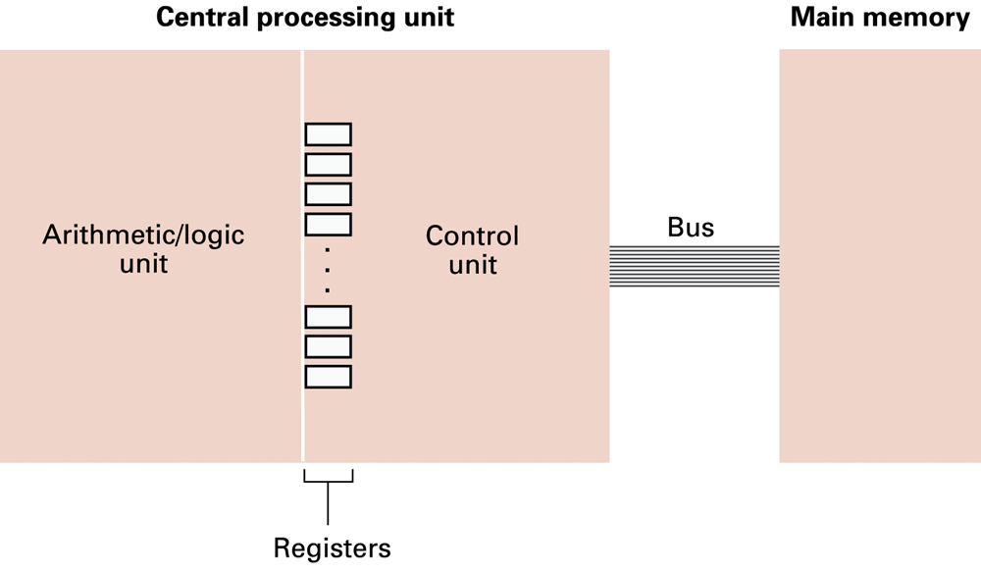
Figure 2.1 CPU and main memory connected via a bus

Slide 3
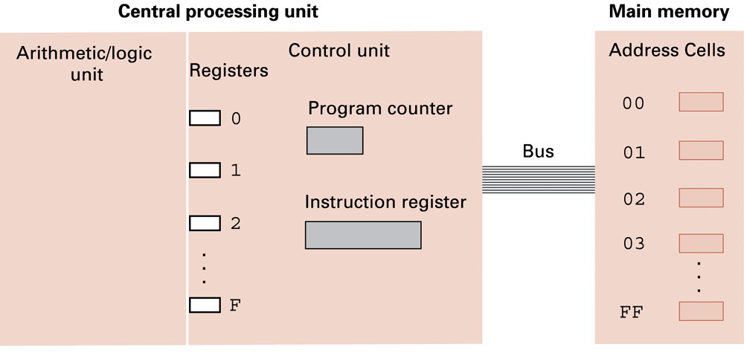
Figure 2.4 The architecture of the machine described in Appendix C

Slide 4
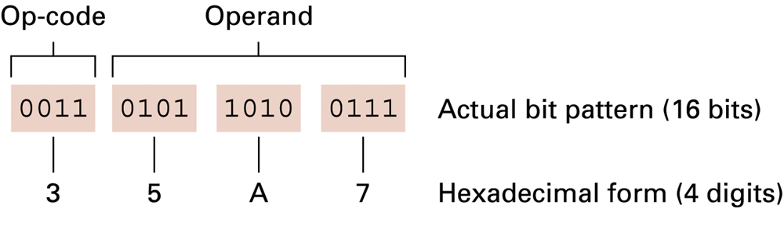
Figure 2.5 The composition of an instruction for the machine in Appendix C

Slide 5
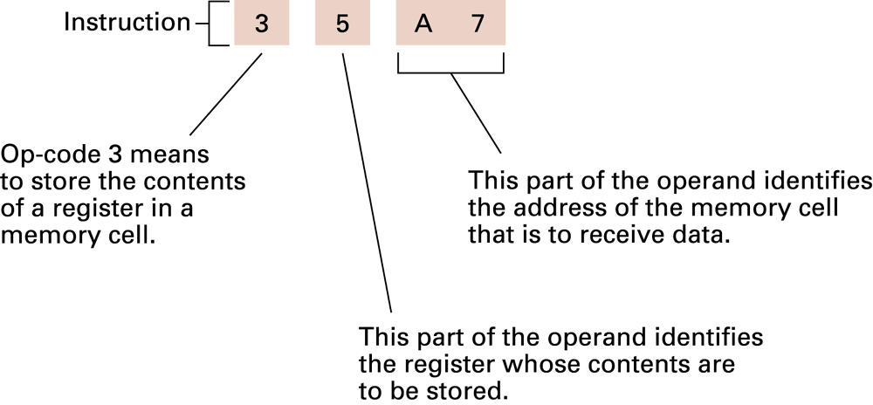
Figure 2.6 Decoding the instruction 35A7

Slide 6
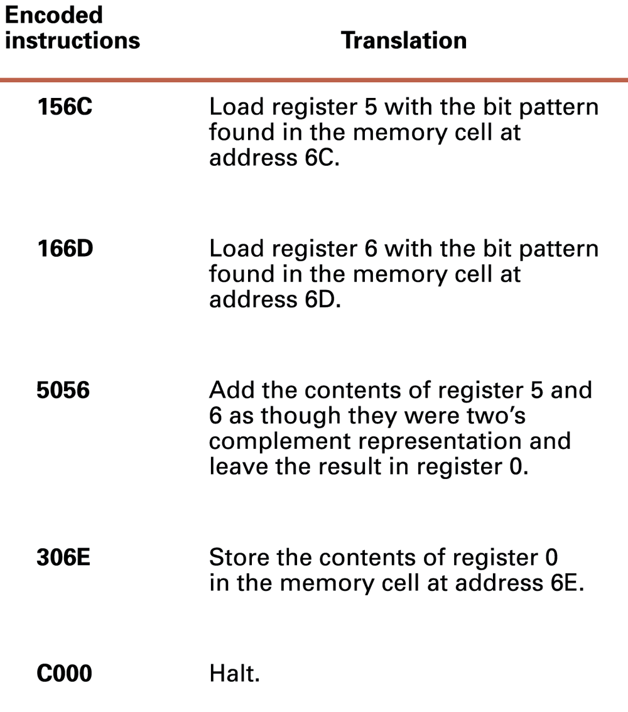
Figure 2.7

Slide 7
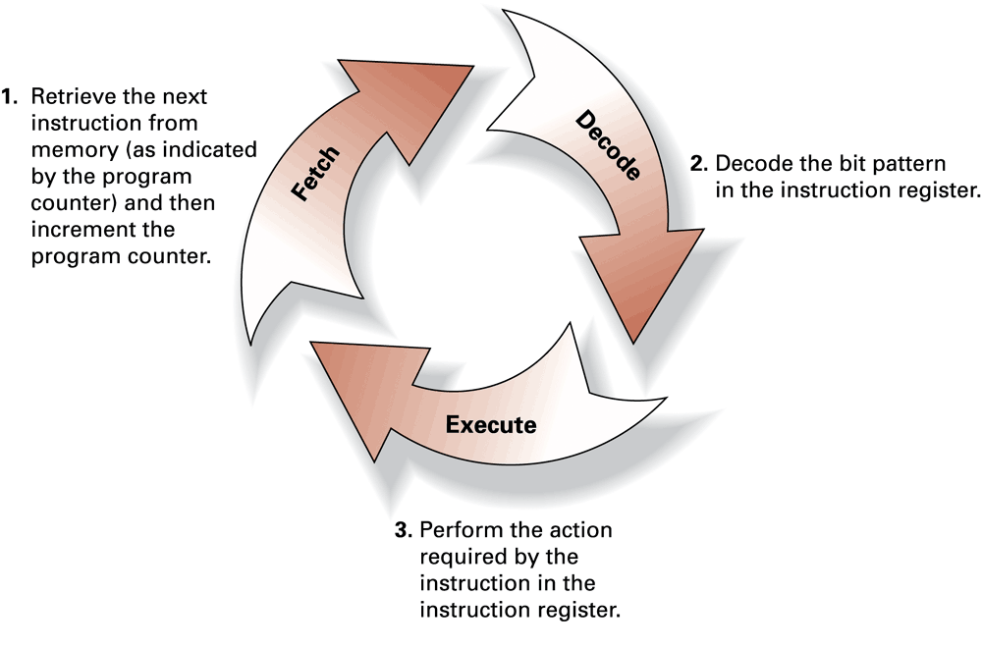
Figure 2.8 The machine cycle

Slide 8
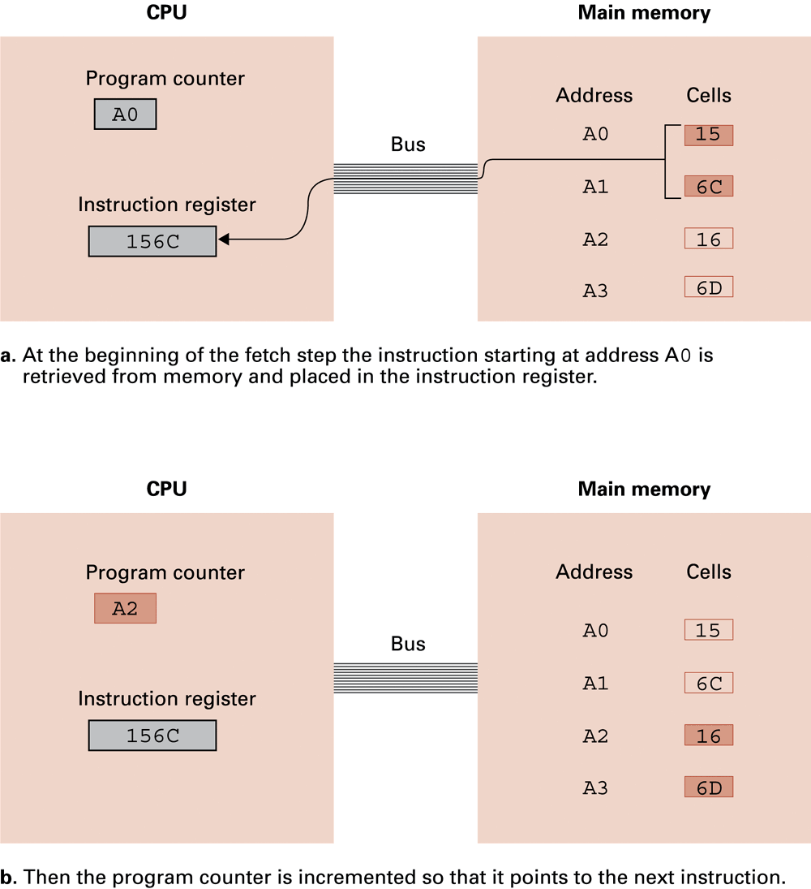
Figure 2.11 Performing the fetch step of the machine cycle

Slide 9
Figure 2.11 Performing the fetch step of the machine cycle (cont’d)

